Slide 1
Image Processing Based Automatic Control System for Occupational Health and Safety
Deniz Karakaya
Ege University Computer Engineering

Slide 2

Subject and Purpose
It is a protective equipment monitoring system through real-time visualization aiming to minimize the damage caused by occupational accidents to personnel due to lack of protective equipment.

Slide 3
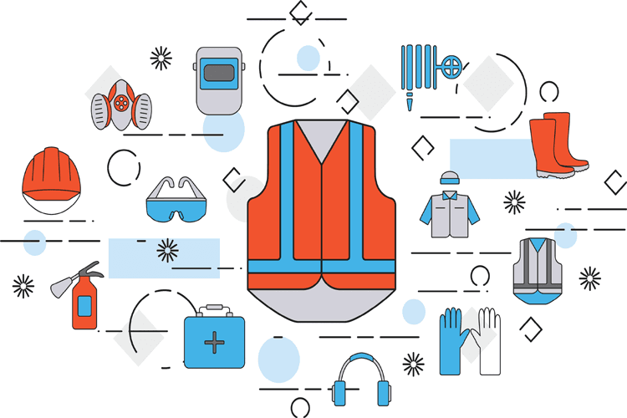
Genuine Value
The systems used to monitor the protective equipment used today have real-time image tracking.
However, there is no system that enables the monitoring of a different protective equipment that has not been introduced to the system by the user.

Slide 4
Impact
According to the records of Social Security Institution in Turkey;
175 - 250 occupational accidents occur every day.
3 - 4 workers are dying every day.
7 - 10 workers become incapacitated every day.
The Gross Domestic Product (GDP) impact is estimated to be about 4% and the total annual cost of occupational accidents is estimated at $ 34 billion.
For these reasons, such a system is an important choice.

Slide 5
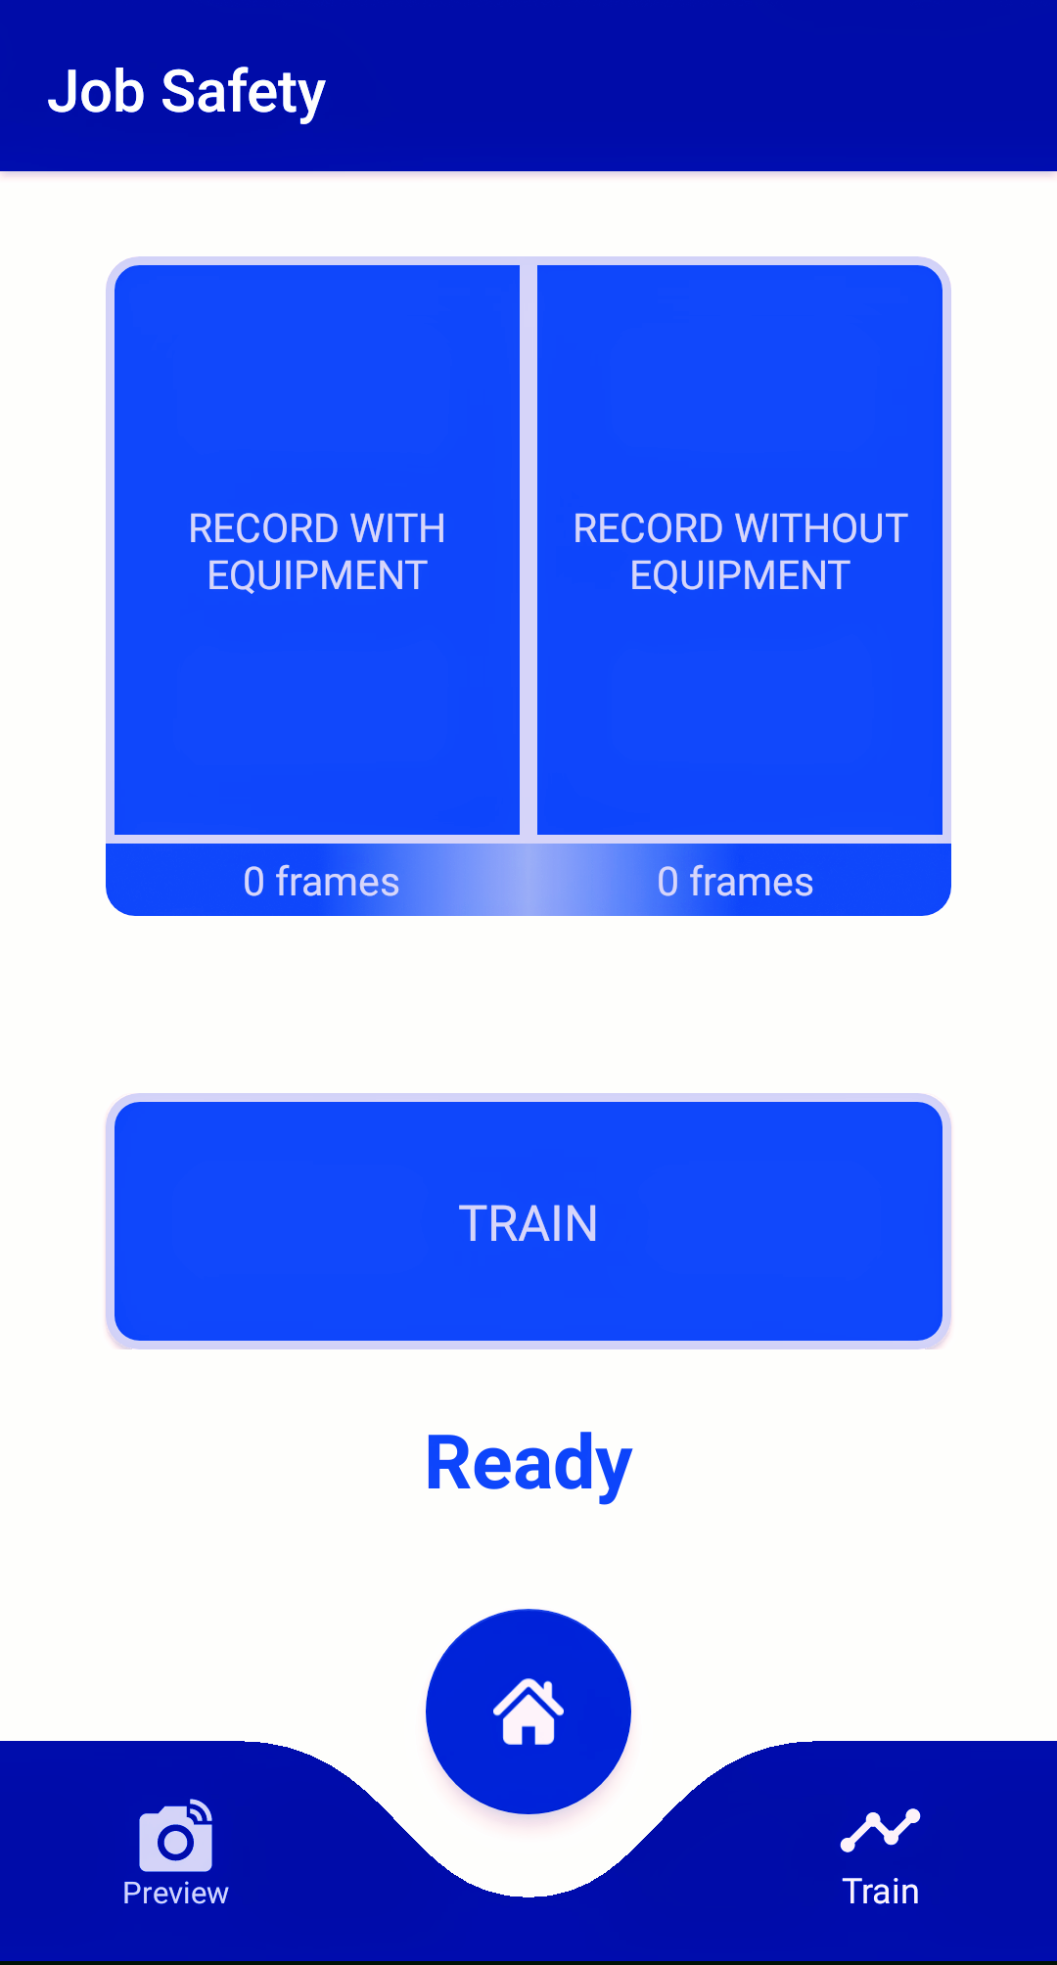
Applicability
In the system, the device is controlled by the application in the smartphone. This application can be used easily because there are many powerful smartphones available today.
The cost of the device is very low and the device can monitor different protective equipment after the user introduces the protective equipment to the existing device through the application in the smartphone without the need for a new device or expert assistance.

Slide 6
Implementation
The device is made of Raspberry Pi. Raspberry Pi camera is used for the camera.
Images taken by the device camera are trained with the Tensorflow library and are also classified with the MobileNet library.
The data flow between the application on the smartphone and the device is provided by sockets.
The TCP / IP protocol is used in the connection between the application on the smartphone and the device.
The client-side application on the smartphone was developed with Java technology, and the server-side device was developed with Python technology.

Slide 7
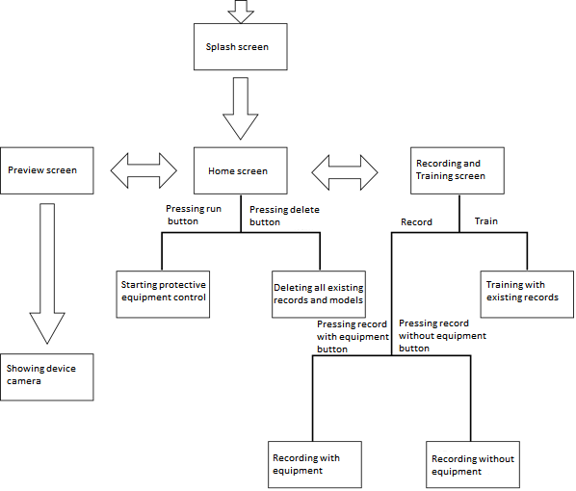

Slide 8

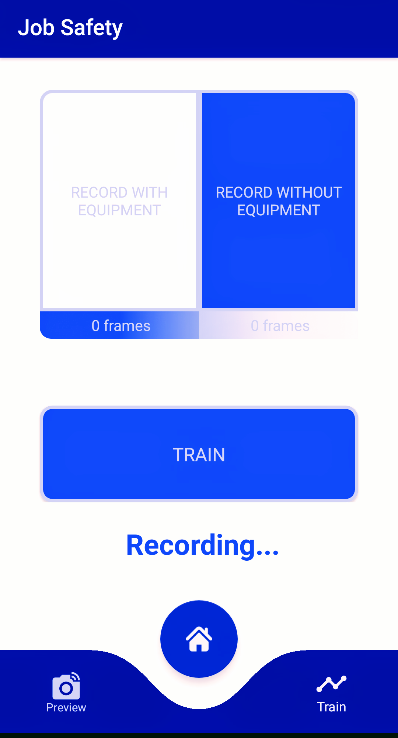
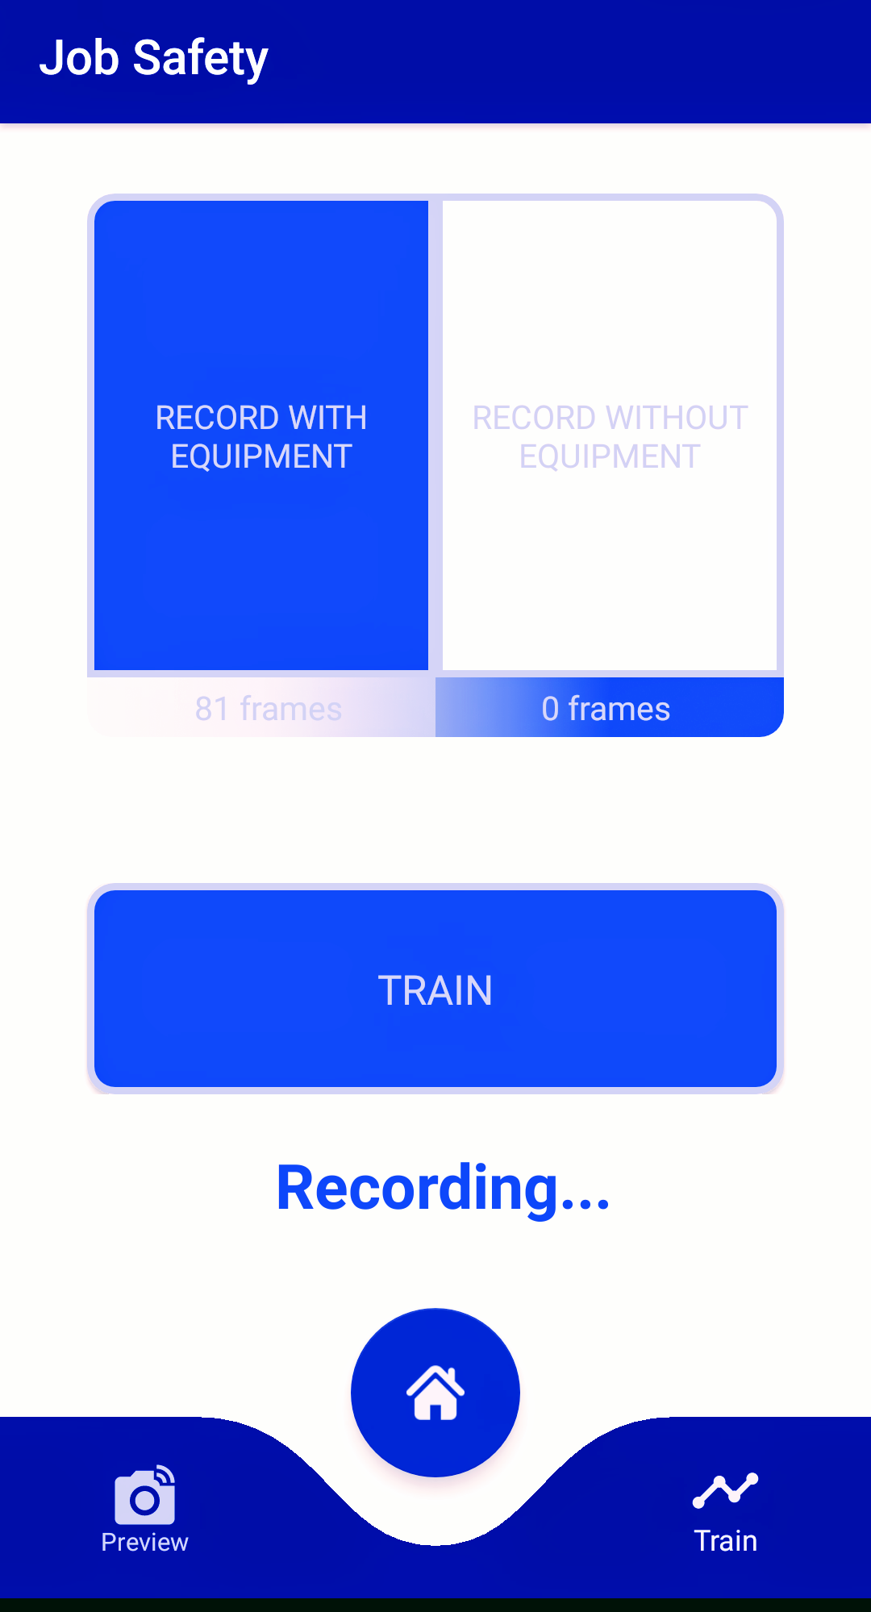
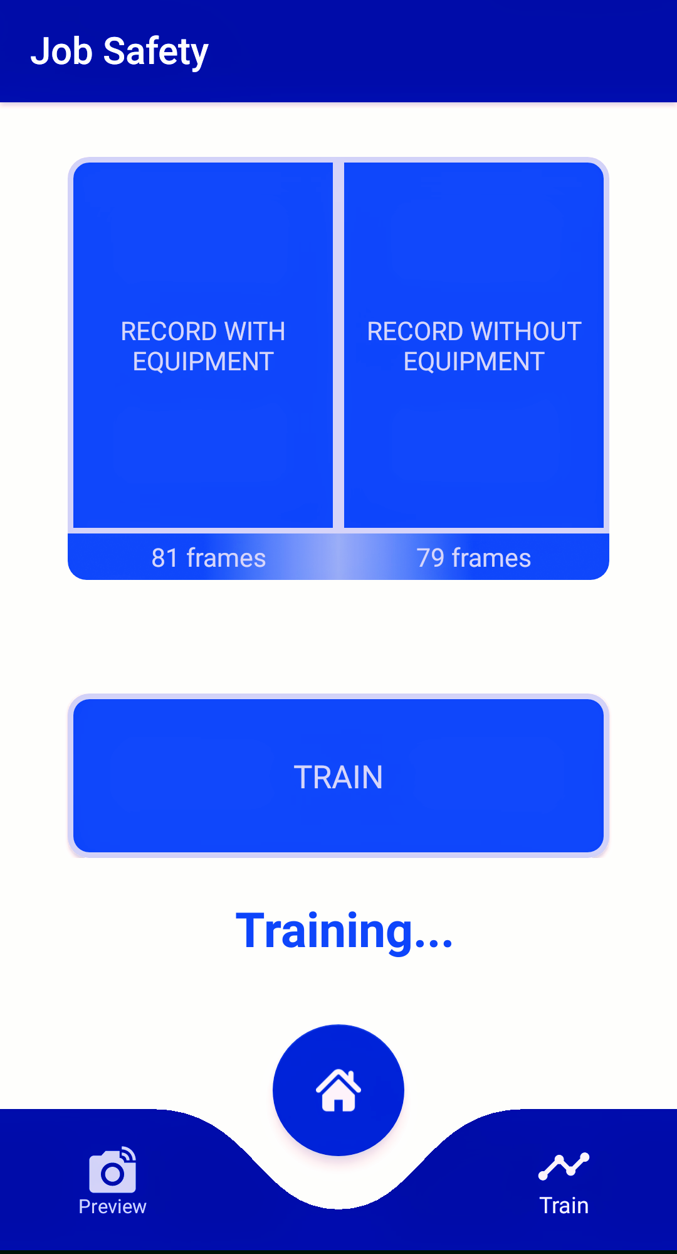
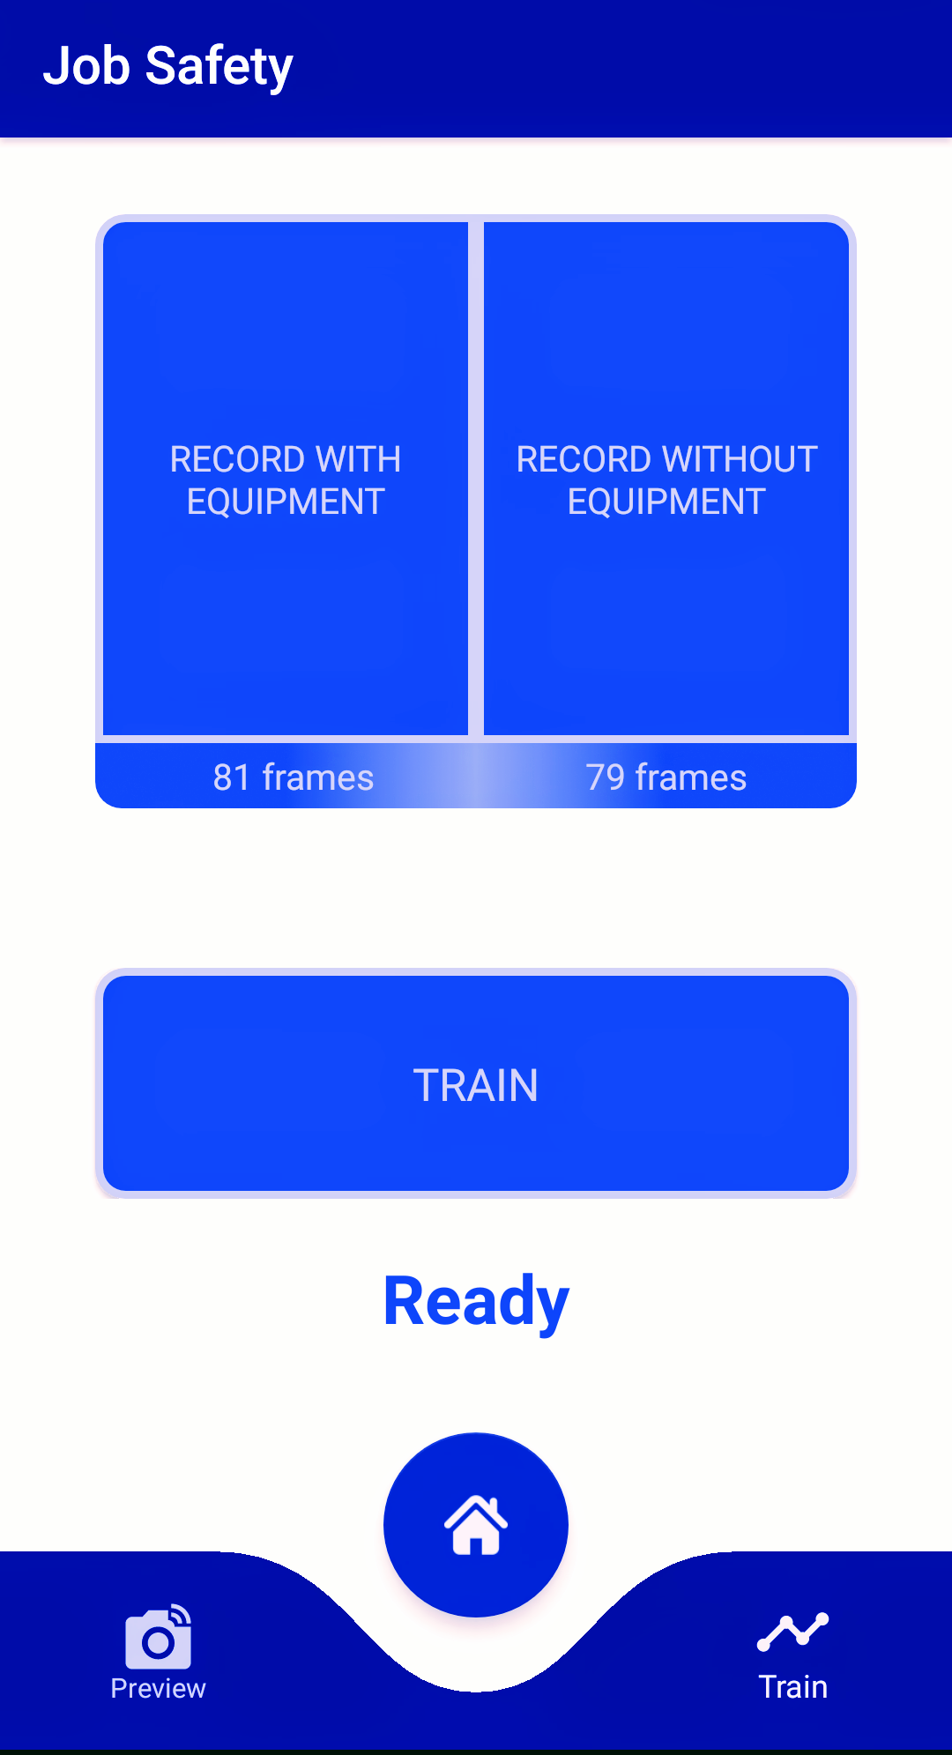
Adding New Protective Equipment to the System
Recording with equipment
Recording without equipment
Training
New equipment ready for control

Slide 9
THANK YOU...
Deniz Karakaya
Ege University Computer Engineering

